Slide 1
UIT2201 – Programming and Data Structures
Lecture-02
Data Representation and Abstraction

Slide 2
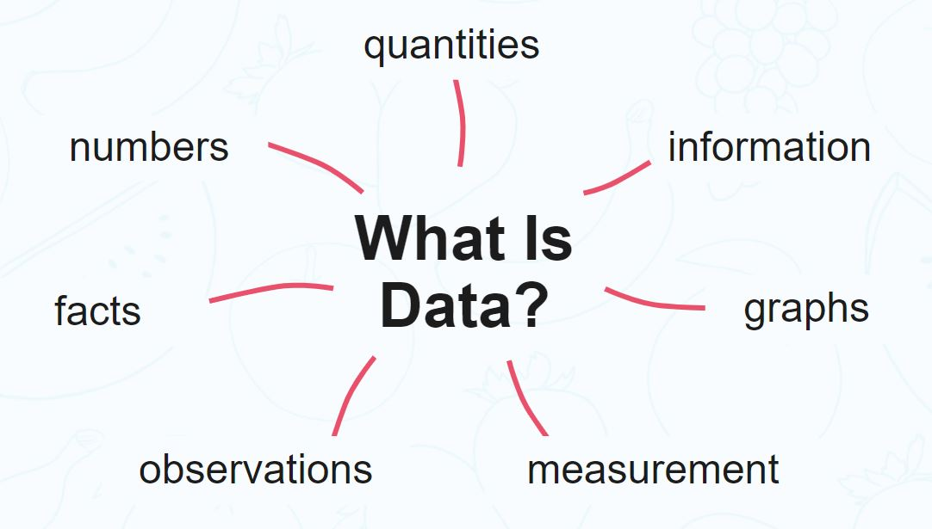
What is Data ?

Slide 3
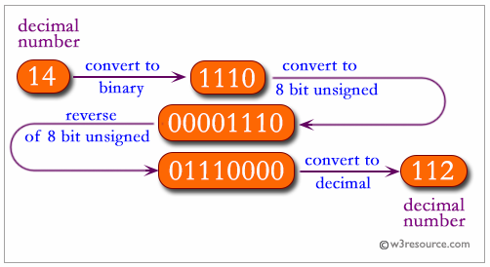
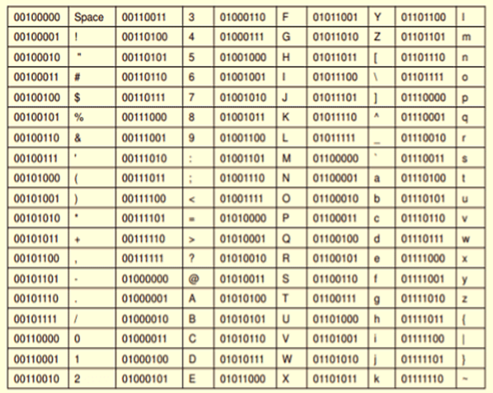
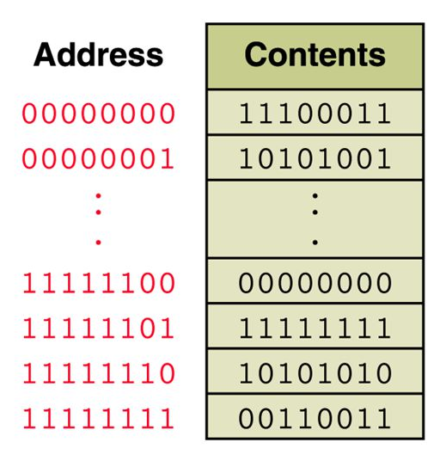
Data Representation

Slide 4
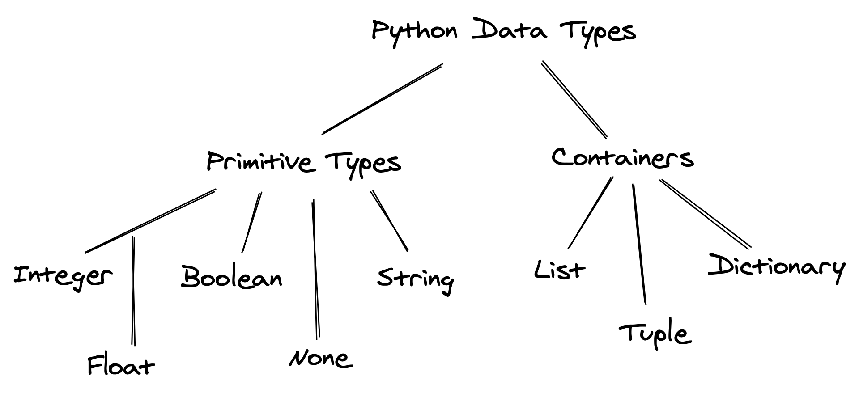
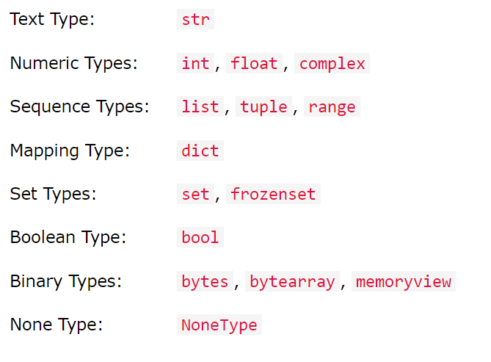
Python Data Types

Slide 5
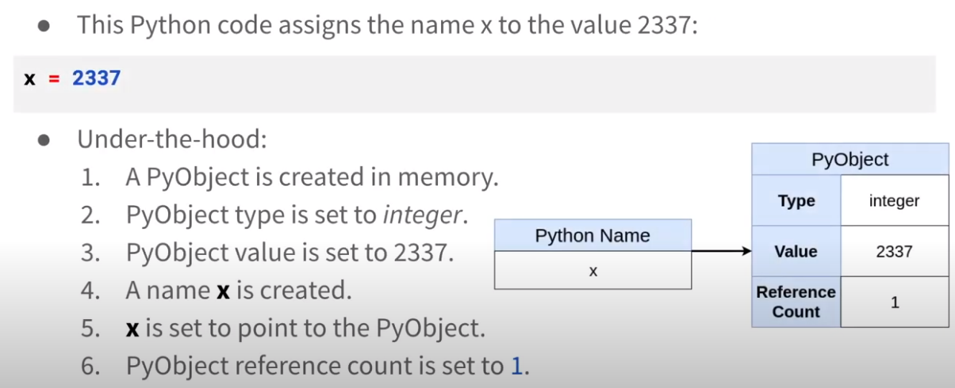
Variables in Python

Slide 6
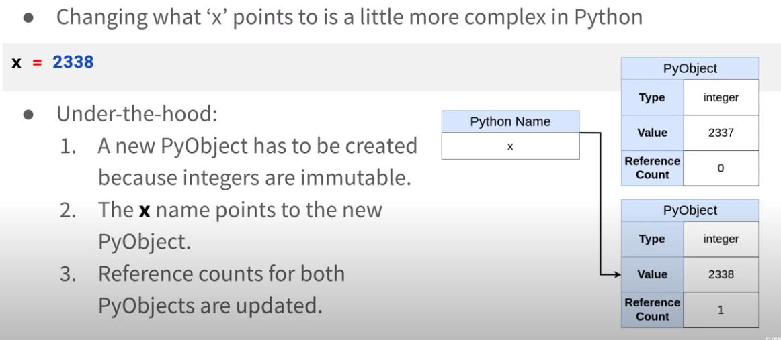
Variables in Python

Slide 7
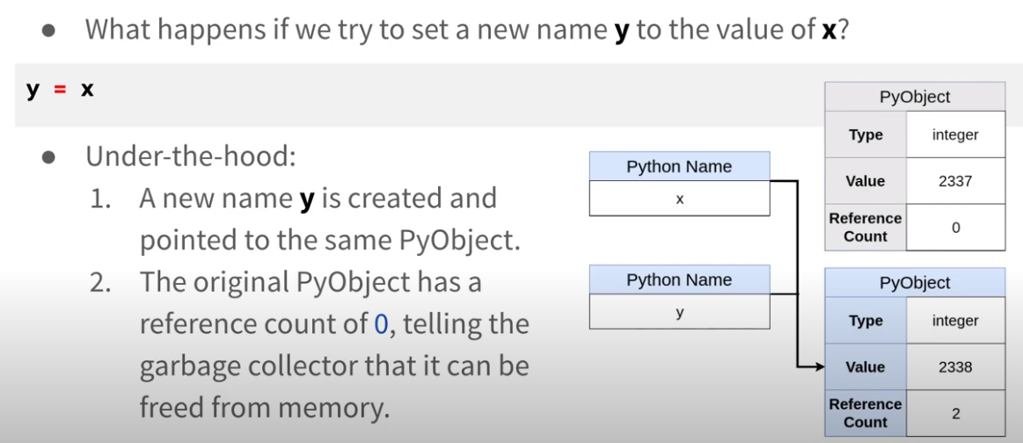
Variable in Python

Slide 8
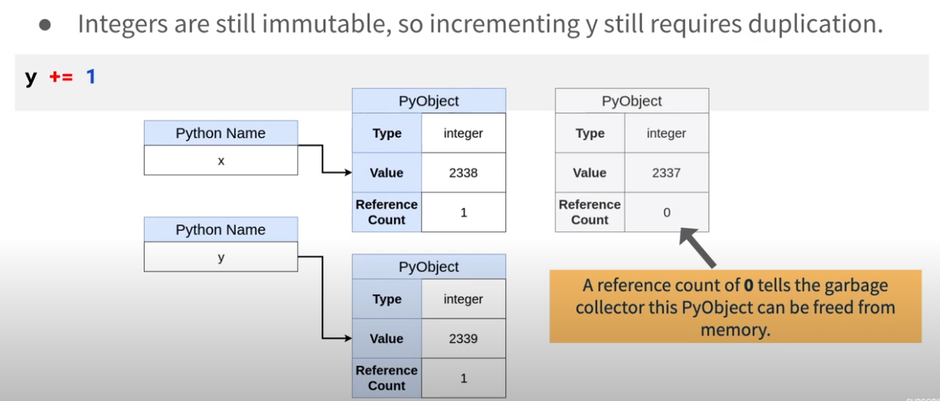
Variables in Python

Slide 9
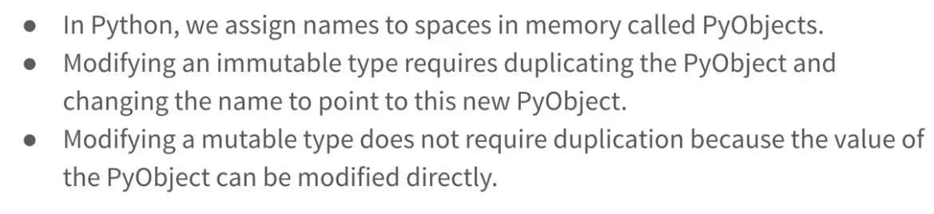
Variables in Python

Slide 10
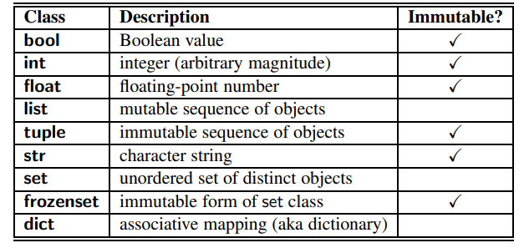
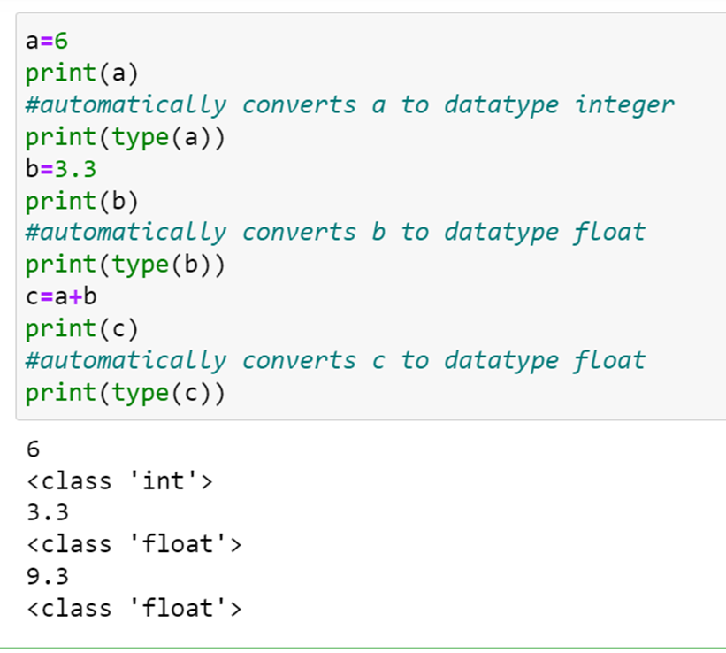
Python Built-In classes
Python is a dynamically typed language, as there is no advance declaration associating an identifier with a particular data type.
An identifier can be associated with any type of object, and it can later be reassigned to another object of the same (or different) type.

Slide 11
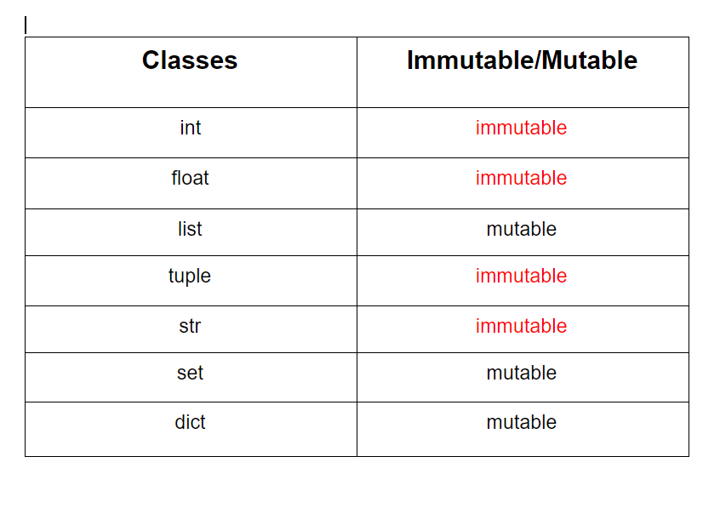
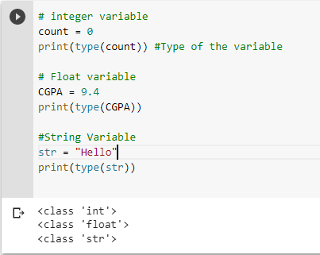
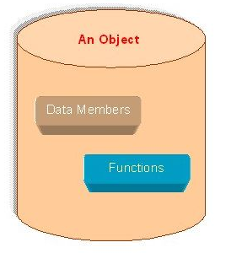
Python Variables
Creating new instance of the object

Slide 12
Calling methods - Member functions
Calling methods - member functions
Python’s classes may also define one or more methods (also known as member functions), which are invoked on a specific instance of a class using the dot (“.”) operator.
Some methods return information about the state of an object, but do not change that state. These are known as accessors
Other methods, such as the sort method of the list class, do change the state of an object. These methods are known as mutators or update methods

Slide 13
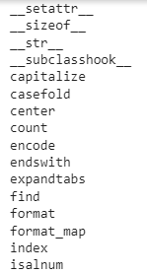
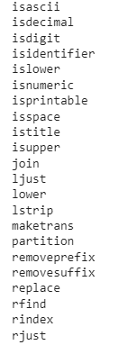

String Class

Slide 14
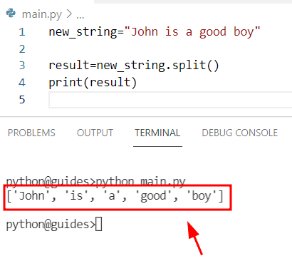
String function

Slide 15
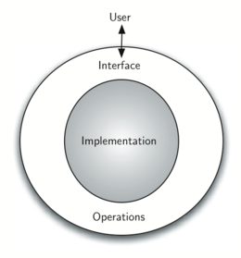
Data Abstraction
Data Abstraction or information hiding refers to providing only essential information to the outside world hiding their background details

Slide 16

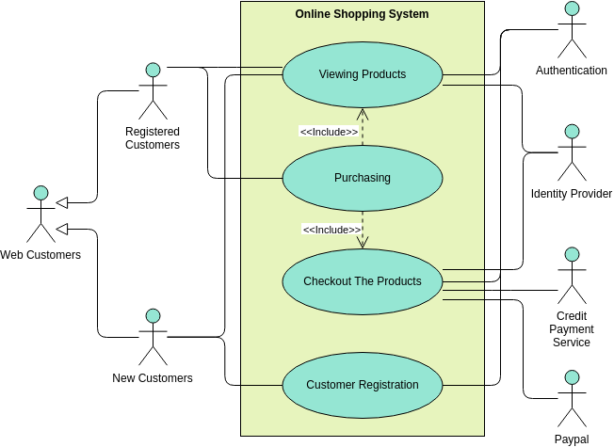
Online shopping application

Slide 17
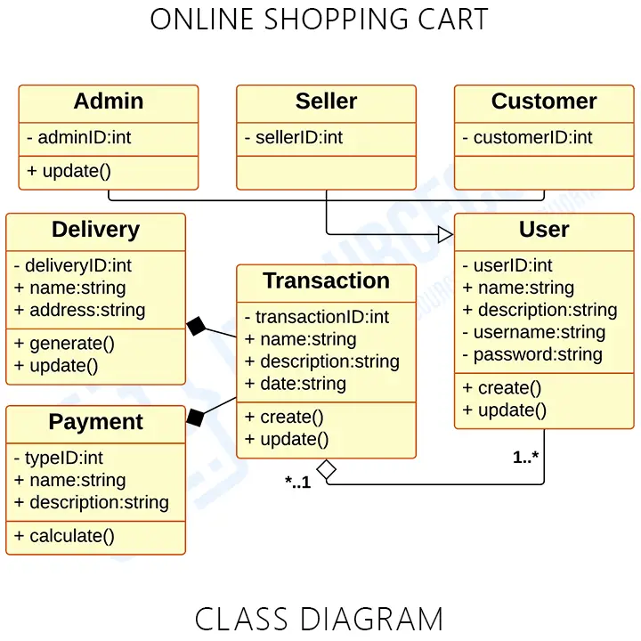
Details on online shopping

Slide 18
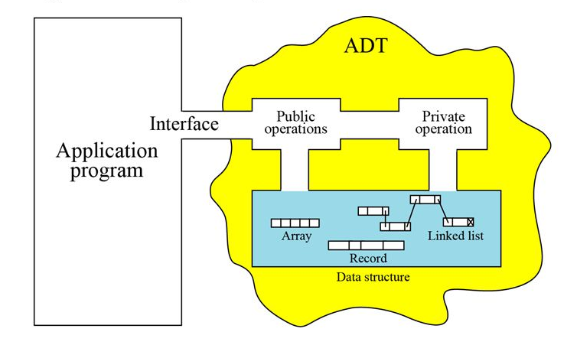
Abstract Data Type
An Abstract Data Type, sometimes abbreviated ADT, is a logical description of how we view the data and the operations that are allowed without regard to how they will be implemented

Slide 19
Abstract Data Type
Abstract Data Type (ADT) — way of representing data along with effective operations on them
Encapsulation — data + operations are designed together and available as a single module (or class)
Abstraction — Exposes only the interface (definitions of operations) and application developers need not worry about how they are implemented
Data Structures is the study of ADTs and effective implementations of them in a chosen programming language
Efficiency of representation and operations is extremely important!

Slide 20
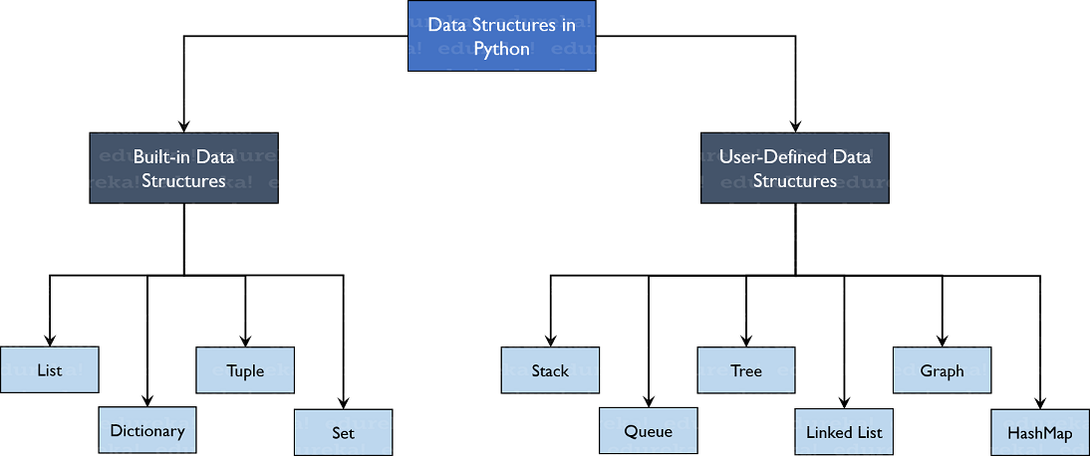
Data Structures in Python

Slide 21
Advantage of ADT
ADT is robust and reusable.
An ADT can be re-used at several places, and it reduces the coding efforts
Allows better conceptualisation and modelling of the real world

Slide 22
Advantages of ADT
It is based on the principles of Object-Oriented Programming (OOP) and Software Engineering (SE).
ADT approach is based on the SE concepts of coupling and cohesion
Coupling property determines, how strongly two separate parts of programs are linked together. Extend to which changes made in one part impacts the other parts of a software module. Well designed software has a minimum coupling. An ADT promotes weak coupling.
Cohesion determines how well-integrated are components of the software. An ADT inherently promotes maximum cohesion.

